Slide 1

FINDING SIMILAR ITEMS IN JOB DESCRIPTIONS
ALGORITHMS FOR MASSIVE DATA COURSE
Presented By : Shojaat Joodi Bigdilo
University Of Milan | June 2024

Slide 2
1
ABSTRACT
In this project, we tackled the challenge of simplifying the job search process by implementing advanced data processing techniques on a large-scale dataset. Using the LinkedIn Jobs & Skills dataset, we focused on identifying pairs of similar job descriptions through the application of shingling, MinHashing, and Locality Sensitive Hashing (LSH), all facilitated by PySpark's robust data handling capabilities. Our approach involved an extensive exploratory analysis, including text preprocessing methods to improve performance. By employing LSH for approximate similarity joins with Jaccard distance, we efficiently detected similar job descriptions across a small chunk of the dataset to avoid the high computation time required for the whole corpus.
Milan University | 2024

Slide 3
2
OVERVIEW
Introduction
Theoretical
Implementation
Dataset
Methodology
Result
Objectives
Data Processing
Conclusion
Milan University | 2024

Slide 4
1
DATASET DESCRIPTION
The dataset is the "LinkedIn Jobs & Skills" from Kaggle.
It contains a variety of job summaries and related information, with the job_summary column being the primary focus for analysis.
Each row contains a job description/summary.
Milan University | 2024

Slide 5
7
OBJECTIVES
Objective 1
Objective 2
Identify pairs or sets of similar job descriptions, providing valuable insights for both recruiters and job seekers.
Implementing advanced data processing techniques such as Locality Sensitive Hashing (LSH) by using Apache Spark
Milan University | 2024

Slide 6
9
THEORETICAL FRAMEWORK
Shingling
MinHashing
Shingling involves breaking down the text into overlapping sequences of words or characters, known as shingles.
“K-shingle” is a sequence of k tokens
Convert Sparse or Dence vectors into compact signature matrix by using the “minhash” functions preserving the information about their similarity.
Jaccard similarity
Locality Sensitive Hashing
Measures how similar two sets are by dividing their “Intersection” size by the size of their “Union”
Ranges from 0 to 1, where 0 indicates no shared elements and 1 indicates identical sets.
LSH is a technique that hashes similar items multiple times into the same buckets with high probability, identifying candidate pairs for similarity checks based on shared buckets.

Slide 7
7
DATA ORGANIZATION
Data Organization
PySpark
The dataset is imported and organized within a PySpark DataFrame to enable efficient handling and processing of large data volumes.
PySpark is designed to handle large datasets that cannot be fitted into a single machine's memory, enabling data processing across multiple nodes in a distributed manner.

Slide 8
7
DUPLICATE AND MISSING VALUES
Counting Unique and Duplicate Documents
Checking for Missing Values
No missing values were found in the Dataset.
So, each job description has at least some words.
All document: 1297332
Distinct document: 958,192
Duplicate documents: 339,140
Duplicate documents were eliminated to avoid extra computation.
For example
checking the result of duplicate columns that the document starts with
"Job Title:\nCertified Nursing Assistant (CNA)\nCompany: . . ."
Repeated 66 times in the dataset.

Slide 9
7
PREPROCESSING TECHNIQUES
Preprocessing Techniques
Pyspark UDF function
Transforming to lowercase
Removing HTML Tags
Removing URLs
Removing Extra Space
Removing Punctuation
Removing numbers
Removing Non-ASCII characters
Tokenization
Removing StopWords
In PySpark, UDFs (User-Defined Functions) allow a user to define a custom function that processes and transforms data within PySpark DataFrames or PySpark RDDs.
Cleans every entry (value) within a specific column of DataFrame.

Slide 10
7
PREPROCESSING TECHNIQUES
Tokenization:
Removing numbers :
Removing numbers from tokens to retain only words.
For example, a document with id = 160 has 42 different numbers inside itself, so these numbers must be deleted
Splitting sentences into sequences of words using the “Tokenizer” method from PySpark MLlib.

Slide 11
7
PREPROCESSING TECHNIQUES
Removing StopWords
Id | Number of tokens | Number of tokens After Stopwords removed | Number of removed Stopwords
160 | 1917 | 1366 | -551
349 | 800 | 497 | -303
589 | 269 | 151 | -118
1319 | 362 | 251 | -111
1324 | 303 | 219 | -84
1803 | 338 | 203 | -135
1928 | 1337 | 889 | -448
Job descriptions are full of stop words (common words like "the" or "a"). These contain around 10-35% of the tokens in the text but don't tell us much about the job itself.
Stop words are Eliminated from the token’s list using the “StopWordsRemover” function from PySpark MLlib.

Slide 12
Algorithm Implementation and Results

Slide 13
4
K-SHINGLING
First Reason
Avoids Noise from Single Words:
With single words, many documents will share common words by chance, making them seem similar. Two-word shingles reduce this noise.
A custom function ‘shingles()’ was implemented to generate shingles from job summaries.
This shingle function generates shingles of a specified length (k=2 in this case) and stores them as a set to ensure uniqueness.
K=2 (two-word shingles) for two reasons:
Second Reason
Captures Meaningful Phrases:
Important concepts like "remote work" or "Python programming", "office work" and "software engineer." lose meaning when split into single words. Two-word shingles keep these phrases intact.

Slide 14
4
SPARSE VECTOR AND EFFICIENCY
In a sparse vector representation, only the non-zero elements are stored.
The rest of the dimensions, which are implicitly zero, are not stored.
Sparsevector(size, [indices], [values]) , size is the total number of dimensions.
For example
Document with Id = 4427:
Vectors.sparse((558004, [36, 3459, 3460, ...], [1.0, 1.0, 1.0, ...])).
558004 shingles in whole corpus
But this document contains shingles with index numbers of 36, 3459, 3460 and so on.
Document contains 93 shingles, So the length of [indices] and [values] array are 93 rather than 558004.
While: Dense Vector: [0.0, 0.0, 0.0, ..., 1.0, ..., 0.0, 1.0, 0.0, ..., 0.0] , size 558004.
Requires storing 558004 binary values for each document.

Slide 15
7
SCALABILITY AND EFFICIENCY OF SPARSE VECTOR
This approach significantly improves the scalability of the solution, especially when dealing with large datasets. Here’s how the solution scales up with data size:
Memory Efficiency
Computational Efficiency
Comparison for Document Id = 4427:
Sparse Vector: Stores only 93 non-zero values (indices and values) and a size attribute, totaling about 6.79 KB.
Dense Vector: Stores all 558,004 dimensions, even zeros, requiring 17,437.68 KB.
The dense vector uses over 2,500 times more memory than the sparse vector
Sparse vectors improve computational efficiency by reducing the number of operations needed.
Operations on sparse vectors can be restricted to non-zero elements, which is faster than processing all elements in a dense vector.

Slide 16
7
MinHashLSH function
MinHashLSH function in PySpark MLlib library is a Locality Sensitive Hashing (LSH) scheme for the Jaccard distance metric.
MinHashLSH function
The MinHashLSH function transforms the input feature vectors to multiple hash values, creating a signature matrix or hash table.
The input features are sparse vectors which they are calculated in the last step for each document (job summary).
MinHashLSH( inputCol, outputCol, seed, numHashTables: int = 1)
numHashTables determines the number of hash functions.
In this case, 20 hash functions are used to make balance between accuracy and performance.
For example: Result of Signature Matix or Hash Table for document id = 160:
[DenseVector([817945.0]), DenseVector([84975.0]), DenseVector([1314580.0]), .......... DenseVector([2619402.0])]

Slide 17
7
ApproxSimilarityJoin function:
This computes the locality sensitive hashes for the input rows, then performs an approximate similarity join between the transformed DataFrame and itself, calculating the Jaccard distance between the vectors (job_summary).
Formula: approxSimilarityJoin(datasetA, datasetB, threshold: float, distCol: str = 'distCol')
How it works:
Uses Signatures Matix (hash values) created by MinHashLSH.
Calculates approximate Jaccard distance between job_summaries.
Filters out self-pairs and keeps only those below a threshold (0.6 in this case).

Slide 18
6
RESULTS
Overview
The dataset was processed in “small chunks” to manage the large volume of data efficiently.
Key Results:
Detected pairs of similar job summaries with Jaccard Distance < 0.6.
Table of similar job summaries sorted by Jaccard Distance in ascending and descending order.

Slide 19
7
COMPARING DANCE AND SPARSE VECTOR RESULT
Dence Vector
Sparse Vector
minhashLSH operation with 5000 documents, if we use shingles_to_one_hot_vector, Computation time is 17.329
minhashLSH operation with 5000 documents, if we use shingles_to_sparse_vector,
Computation time is 7.484,
around 2.5 times faster.
Milan University | 2024

Slide 20
7
JACCARD DISTANCE
Table of Similar Job Summaries
idA | idB | JaccardDistance
503 | 948 | 0.0
107 | 406 | 0.0
544 | 963 | 0.0
1623 | 2337 | 0.0
1213 | 1812 | 0.0
Top 6 rows of a dataset sorted by Jaccard Distance in ascending order.
idA: The identifier of the first document in the pair being compared.
idB: The identifier of the second document in the pair being compared.
These rows indicate pairs of documents with identical or highly similar content.

Slide 21
7
JACCARD DISTANCE
The documents with IDs 503 and 948 have a Jaccard distance of 0, which indicates very high similarity between the two documents. However, despite having the same words after preprocessing, the original texts are not identical. This suggests that the difference might lie in stopwords or punctuation that were removed during preprocessing.
ID = 503
ID = 948
“Description\nOur\nRestaurant Team/Shift Leaders\nhave a dual role - youÃ¢Â\x80Â\x99ll serve as both a restaurant leader and a team member. As a leader, youÃ¢Â\x80Â\x99ll work closely with the Restaurant Manager ensuring all operating procedures are followed. YouÃ¢Â\x80Â\x99ll also assist with scheduling, training and supervising Team Members to ensure each customer enjoys a hot, freshly-prepared product using the highest quality ingredients served in a comfortable, clean, friendly environment.\nWhat's In It For You....”
“Description\nOur\nRestaurant Team/Shift Leaders\nhave a dual role - youÃ¢Â\x80Â\x99ll serve as both a restaurant leader and a team member. As a leader, youÃ¢Â\x80Â\x99ll work closely with the Restaurant Manager ensuring all operating procedures are followed. YouÃ¢Â\x80Â\x99ll also assist with scheduling, training and supervising Team Members to ensure each customer enjoys a hot, freshly-prepared product using the highest quality ingredients served in a comfortable, clean, friendly environment.\nWhat's In It For You....”

Slide 22
7
JACCARD DISTANCE
Table of Similar Job Summaries
idA | idB | JaccardDistance
3284 | 4955 | 0.59989
4051 | 4261 | 0.59975
3187 | 4189 | 0.59951
3771 | 4880 | 0.59929
3817 | 3882 | 0.59922
Similarity of pairs of documents with distance < 0.6 sorted in descending order
Pair of documents with IDs 3284 and 4955 have a Jaccard Distance of 0.59, suggesting a relatively low level of similarity between these two documents, as a higher Jaccard Distance value (closer to 1) indicates greater dissimilarity.

Slide 23
7
JACCARD DISTANCE
Similar Documents (IDs 1909 & 3014):
Jaccard Distance of 0.20. quite similar
Share lots of unique words after preprocessing.
This high degree of overlap indicates that they discuss very similar topics with slightly different wording or additional unique content in one of the documents.
Documents with Jaccard Distance between 0.2 and 0.3
idA | idB | JaccardDistance
1909 | 3014 | 0.20054
3058 | 3148 | 0.20081
2023 | 2036 | 0.20105
1602 | 2205 | 0.20110
2205 | 2223 | 0.20110

Slide 24
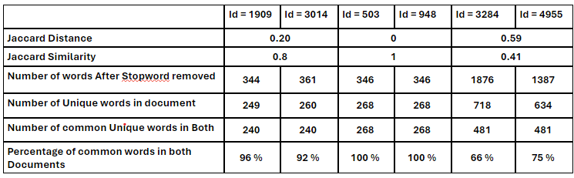
7
Comparison of Some Document Pairs
In this part, one document as an example from each of the above tables will be analyzed by the number of words contained inside each of them to get more information about the similarity of documents.

Slide 25
Additional Method
Problems and
Discussion

Slide 26
12
Discu﻿ssion
When we increase the number of documents from 50000 to 10000, also 20000, 50000, and 100000, even if I don't talk about 1 million documents, in this situation, the MinhashLSH function is calculated in some seconds, Also the " approxSimilarityJoin" function will be calculated in some seconds. But, the problem is when you want to call result_filtered.show(10) function to show the result of JaccardDistance for 10 document pairs, unfortunately, this function does not show the result immediately, it takes some hours and finally gives an error. the problem is when it runs to show the result, the capacity of the disk in Google Collab increases enormously for example, from 33 GB to 76 GB. This increase causes an error and stops the whole process because the capacity of Google Collab's disk becomes full.

Slide 27
12
Discu﻿ssion
This shows that when we run the result_filtered.show(10) function, when we want to call the data, first, it stores all of the calculated data in the disk, then gives the result, that's the reason when we call the show() function to show the result of 10 pair document, it won't show the result, because I think first, because it brings data from the Spark distributed environment into the local driver memory. As a result, I couldn't find results for a dataset with more than 5000 documents.

Slide 28
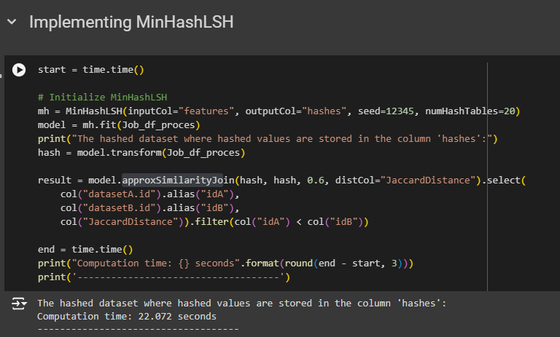




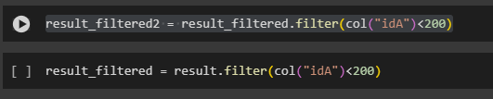
Computation for Chunk with Size 20,000 Document

Slide 29
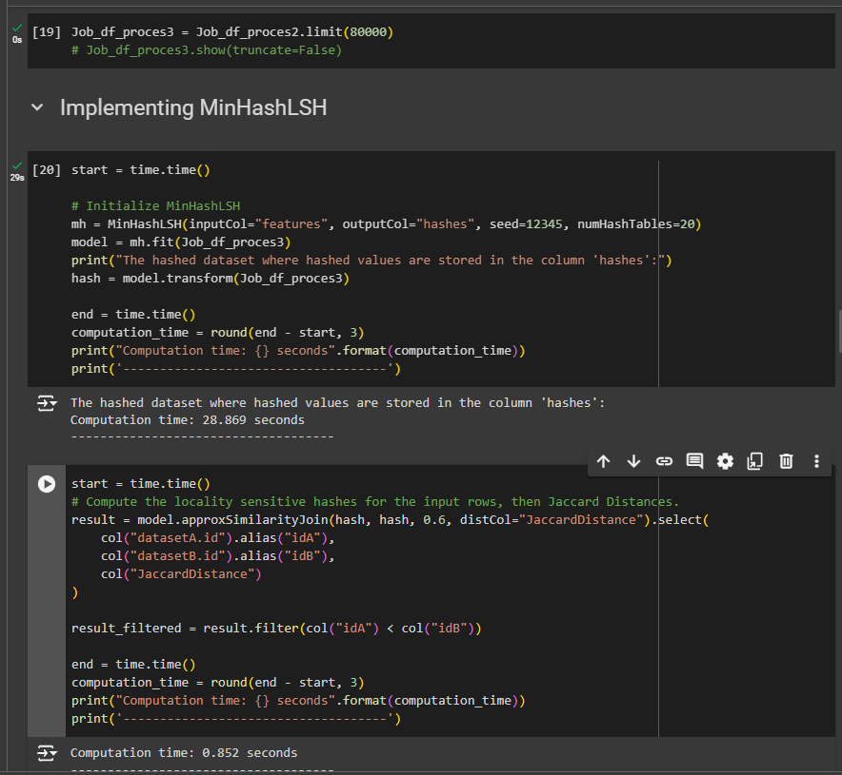
Computation for Chunk with Size 80,000 Document

Slide 30
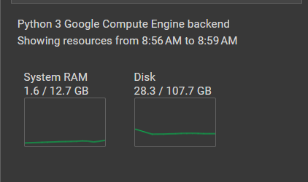
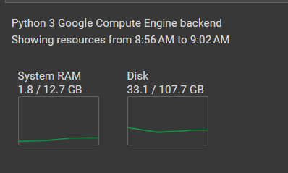
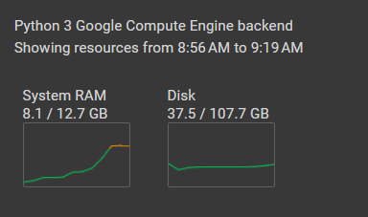
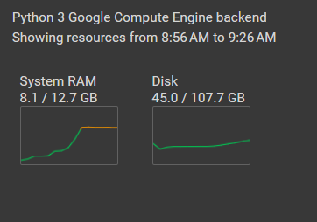
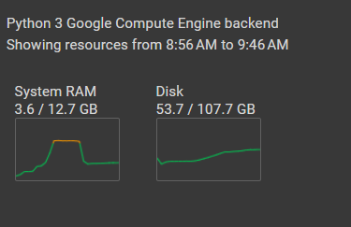
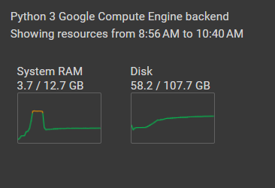
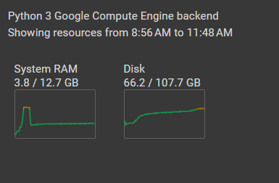


Computation for Chunk with Size 20,000 Document

Slide 31
OTHER ERROR

Slide 32
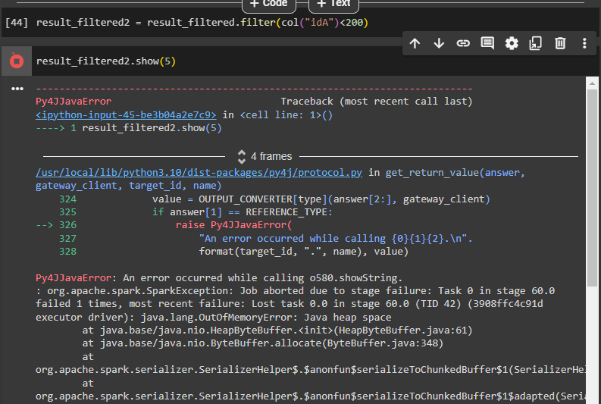
Error for Chunk with Size 10,000 Document

Slide 33
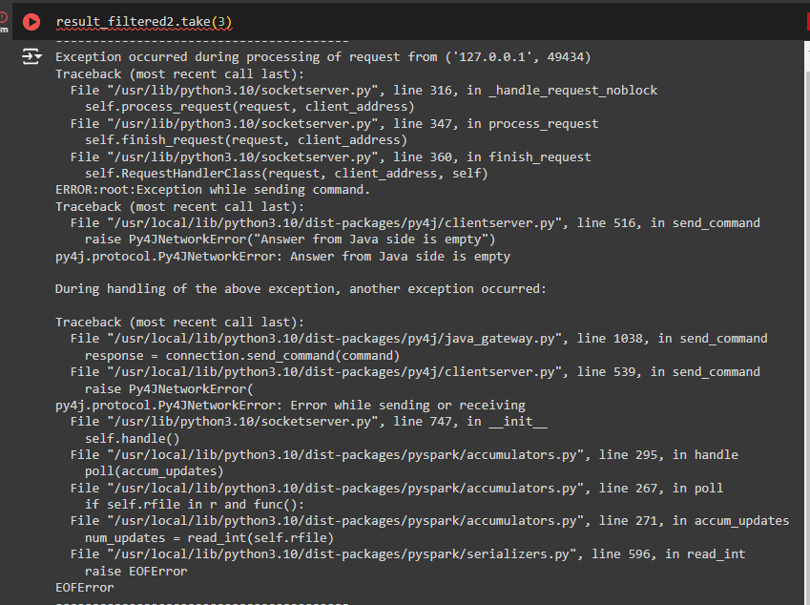

Slide 34
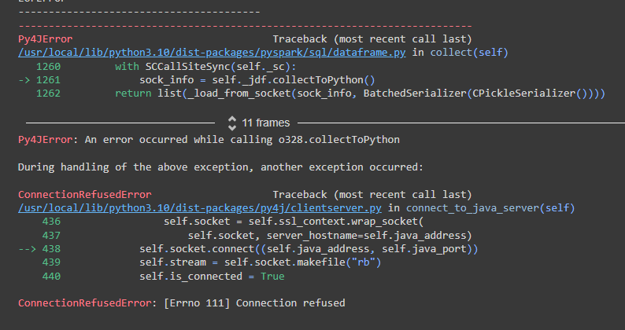

Slide 35
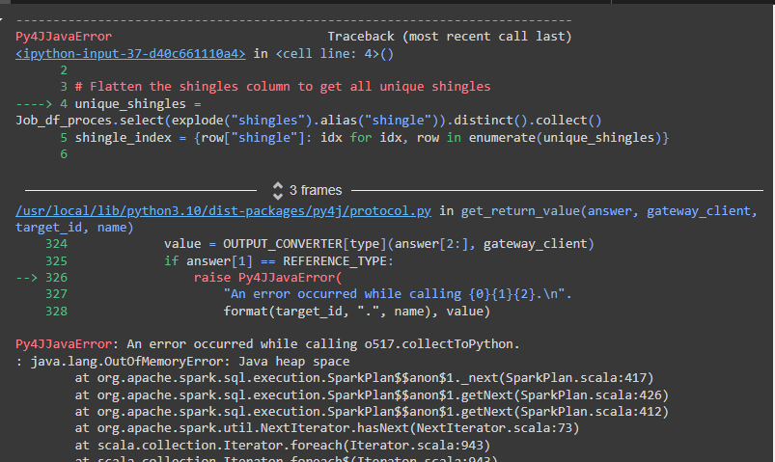
Error for Chunk with Size 600,000 Document

Slide 36
12
CONCLUSION
This project employs a sophisticated strategy to handle large datasets effectively by processing them in manageable chunks. By combining Locality Sensitive Hashing (LSH) and MinHash signatures, the implemented code accurately identifies similar job descriptions with high efficiency. However, collecting and showing the result for a big corpus of more than 5000 documents is not possible, because of disk limitations in Google Collab and also some other errors that happen while calling the result to show them.

Slide 37
THANK YOU

